Slide 1
The Fisch Tank
By Charity Fischer

Slide 2
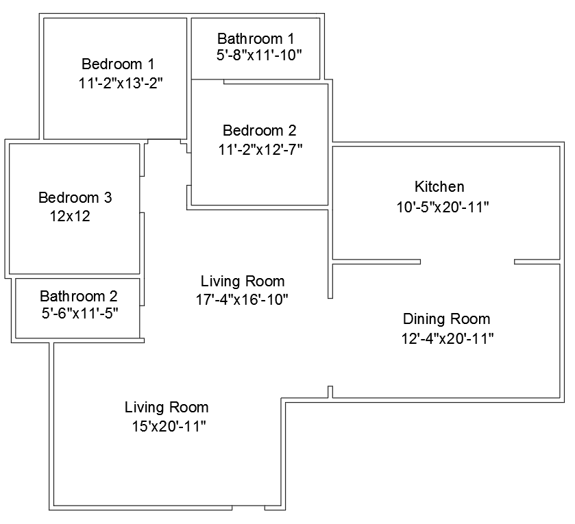
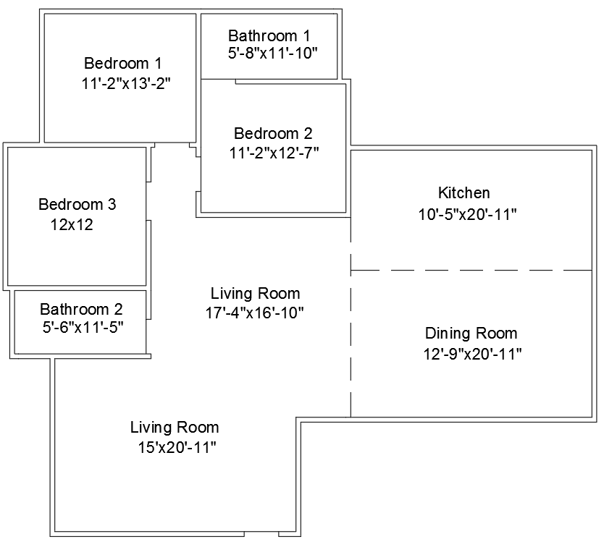
The Fisch Tank
3 Bedroom
2 Bathroom
Spacious living area
Sizable dining room and kitchen

Slide 3
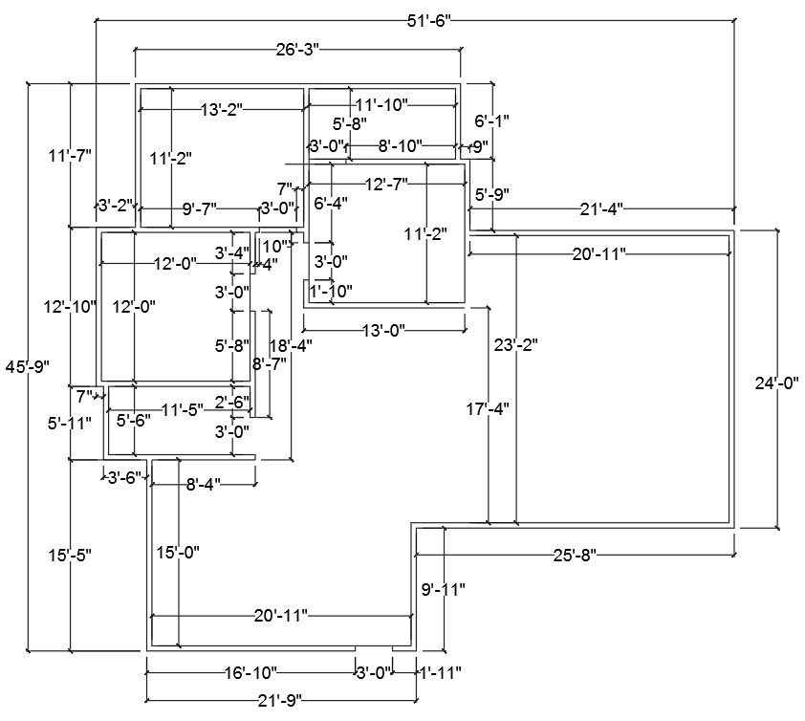
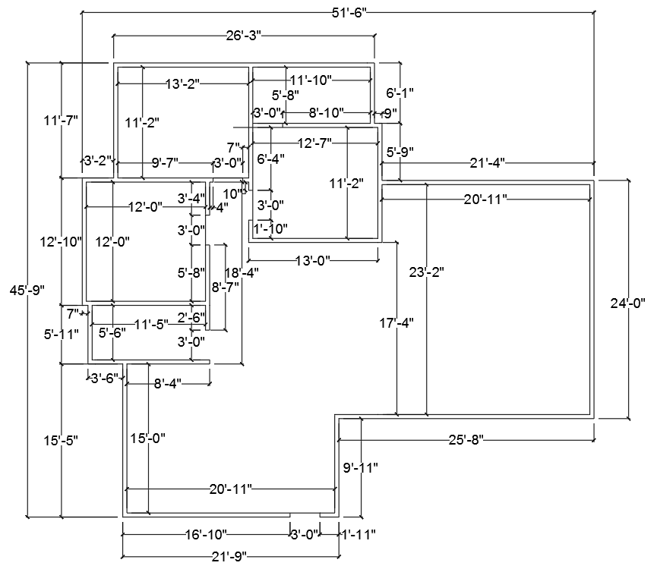
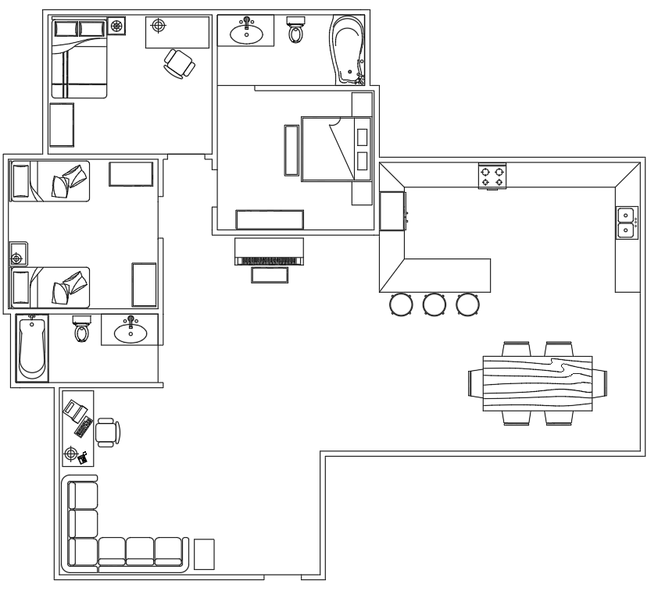
The Fisch Tank
  Houses 1-6 people
  2 Shower Baths
  1,660 sqft

Slide 4
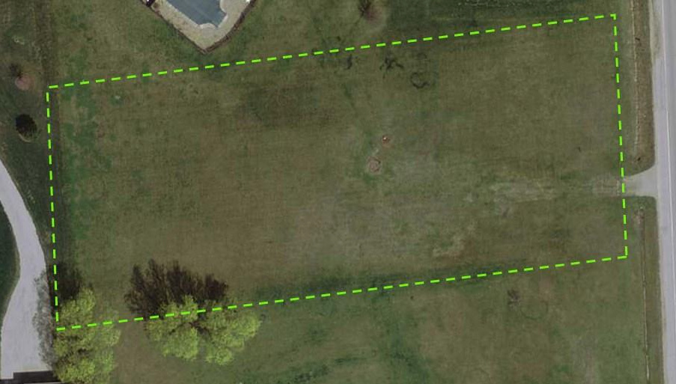
Cost to Build
1 acre
$39,000
Schwartz rd and Flutter

Slide 5
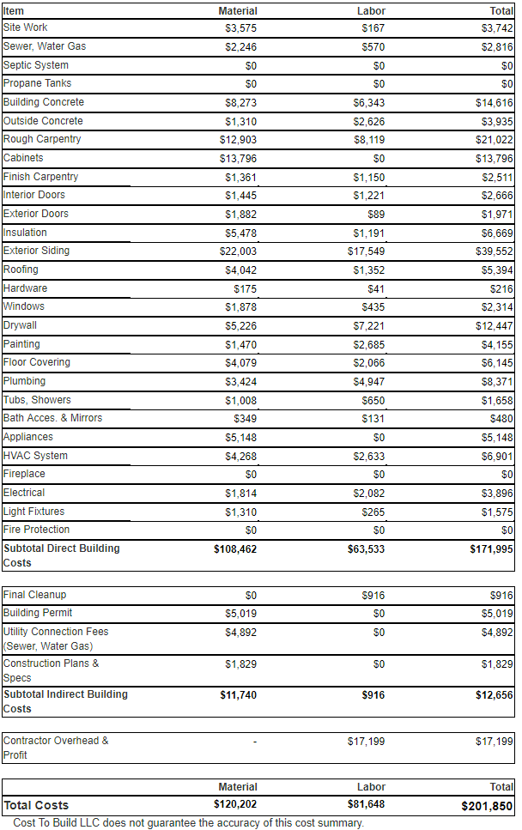
Cost to Build
$39,000 for land
$120,000 for materials
$82,000 for labor
$241,000 total
Notes:
Possibly less on labor

Slide 6
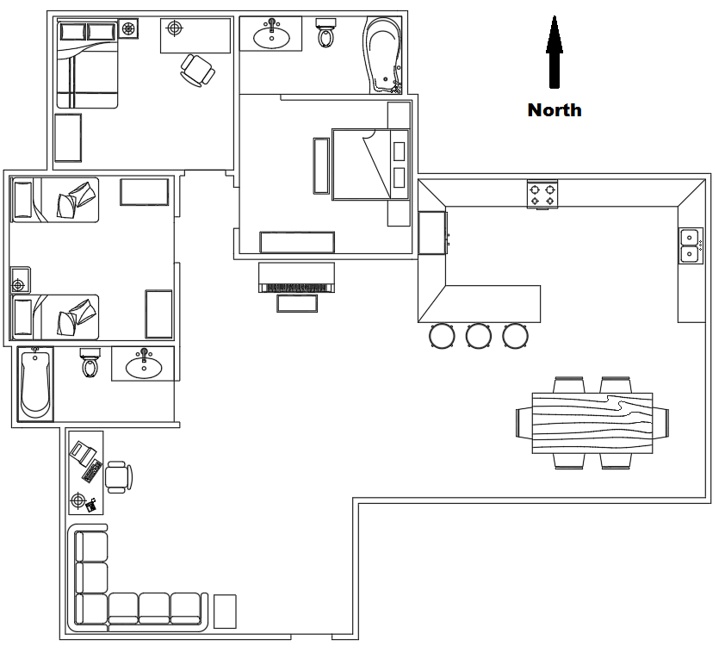
Interesting Points
Brick siding
5:12 roof
South facing front door
East dining room window facing road and fields beyond
Bar counter

Slide 7

Interesting Points
No closets
No laundry room
No basement or second floor

Slide 8
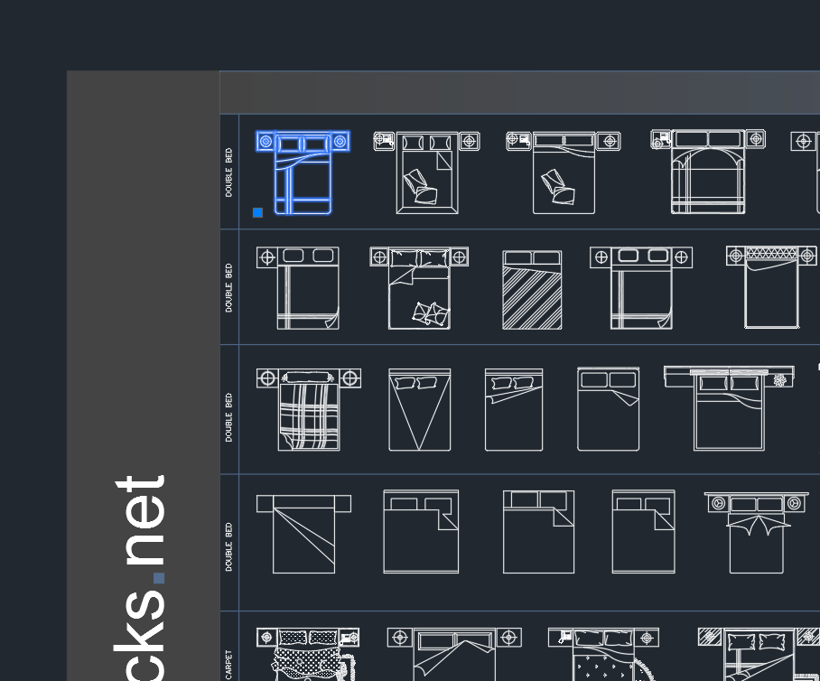
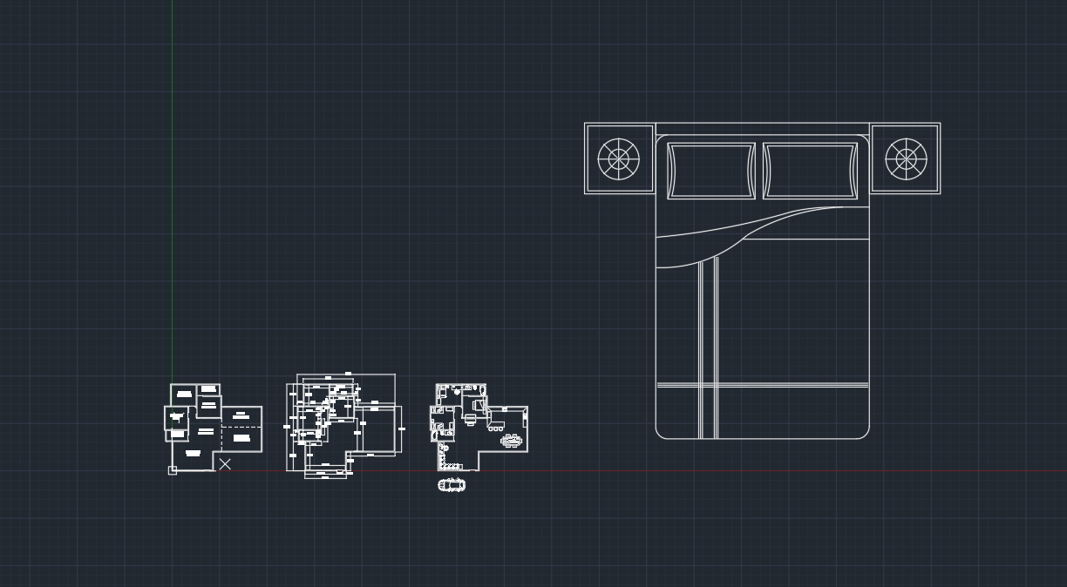
How It Was Made

Slide 9
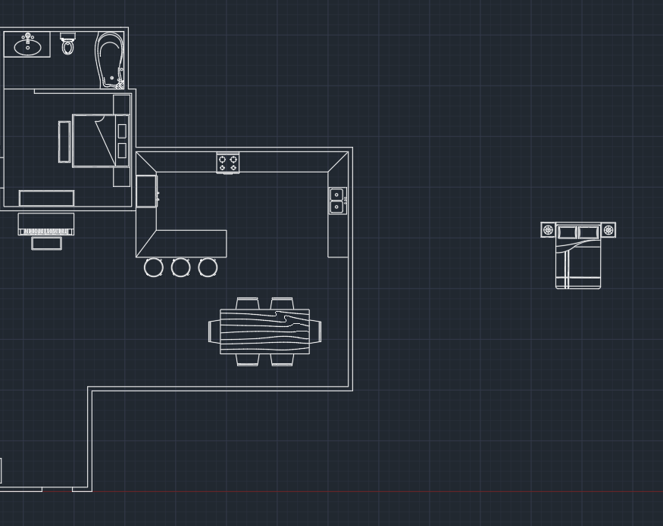
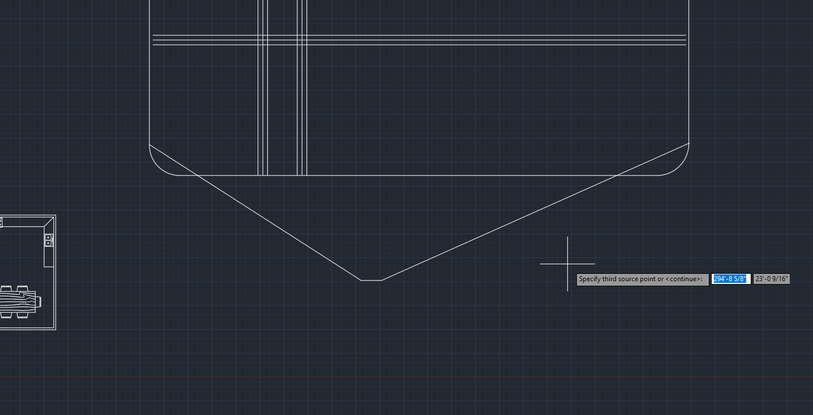
How It Was Made

Slide 10
References
http://costtobuild.net/calculator.html
https://www.coldwellbanker.com/property/8801-Schwartz-Fort-Wayne-IN-46835/M-201751079-IN_LBAR/detail

